Slide 1
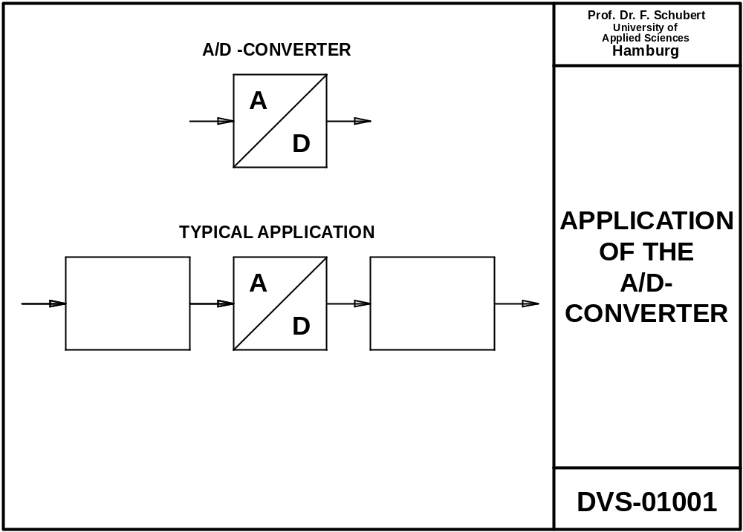
Physical value
Digital processing
Sensor
Analog signal as
electrical value (voltage or current)
Digital signal

Slide 2
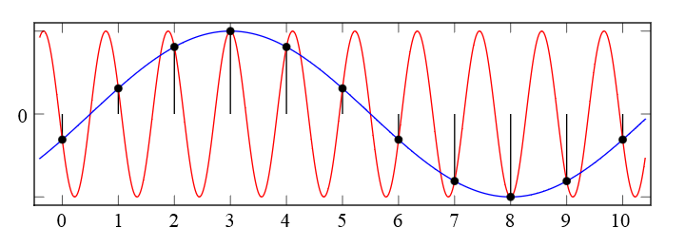
Nyquist Theorem = Shannon Theorem:
Sampling a signal with sampling frequency F_{S}:
When Signal frequencies from 0 to F are present, then the sampling frequency needs to be F_{S}>2F
If this condition is met, the originsl signl can be reconstructed without quality loss
If this condition is not met, then alias frequencies occur, F_{alias}=F_{S}-F

Slide 3
Previous slide showed that undersampling harms.
This video shows that sampling with the correct samping frequency does not harm
Video: 11 min
link

Slide 4
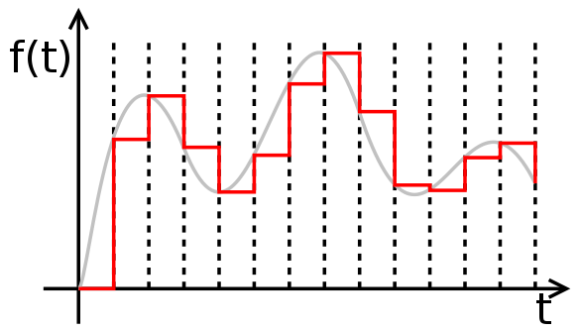
Sampling, quantisation:
ADCs perform
Sampling (taking samples at discrete time steps)
Quantisation (converting analog value (infinite value range) into digital value (finite value range)
Sampling doesn‘t lead to quality loss if sampling theorem is not violated

Slide 5
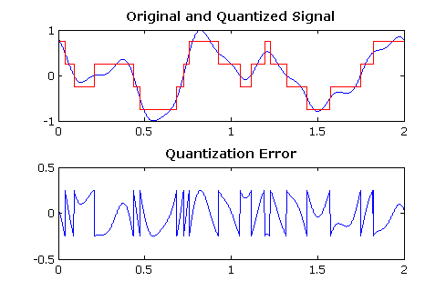
Sampling, quantisation:
ADCs perform
Sampling (taking samples at discrete time steps)
Quantisation (converting analog value (infinite value range) into digital value (finite value range)
Sampling doesn‘t lead to quality loss if sampling theorem is not violated
Quantisation leads to loss in quality (quantisation noise/error):
  8 Bits: Telephone quality
  16 Bits: CD / MP3 player quality

Slide 6
Sampling, quantisation:
ADCs perform
Sampling (taking samples at discrete time steps)
Quantisation (converting analog value (infinite value range) into digital value (finite value range)
Sampling doesn‘t lead to quality loss if sampling theorem is not violated
Quantisation leads to loss in quality (harmonics):
  8 Bits: Telephone quality
  16 Bits: CD / MP3 player quality

Slide 7
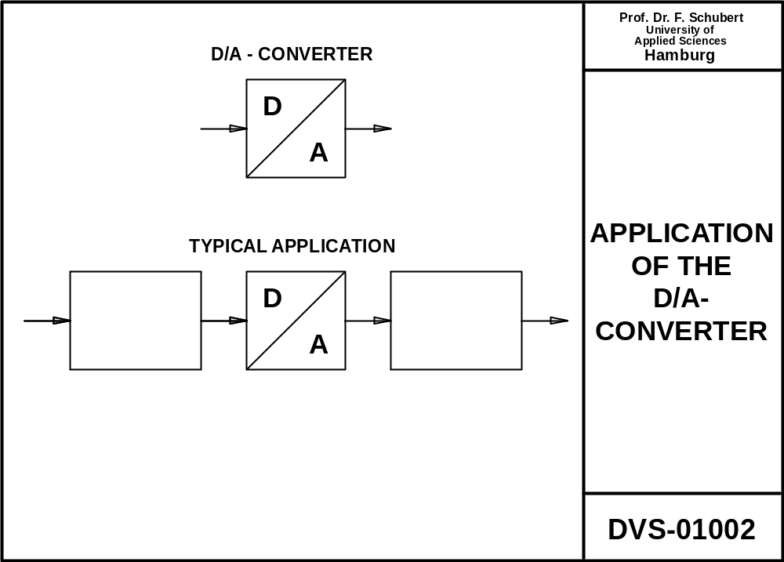
Digital processing
Actuator
Digital signal
Analog signal as
electrical value (voltage or current)

Slide 8
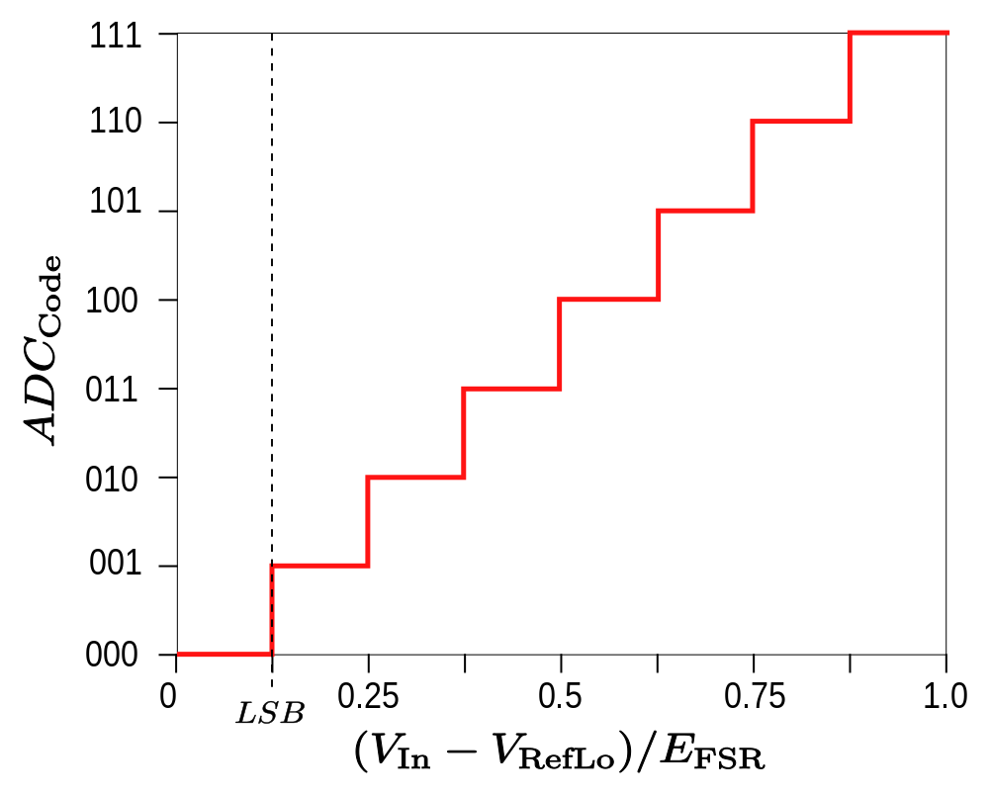

Slide 9
There several non-ideal properties of DACs and ADCs:
Gain error
Offset error
Linearity error (Integral / Deifferential non-linearity)

Slide 10
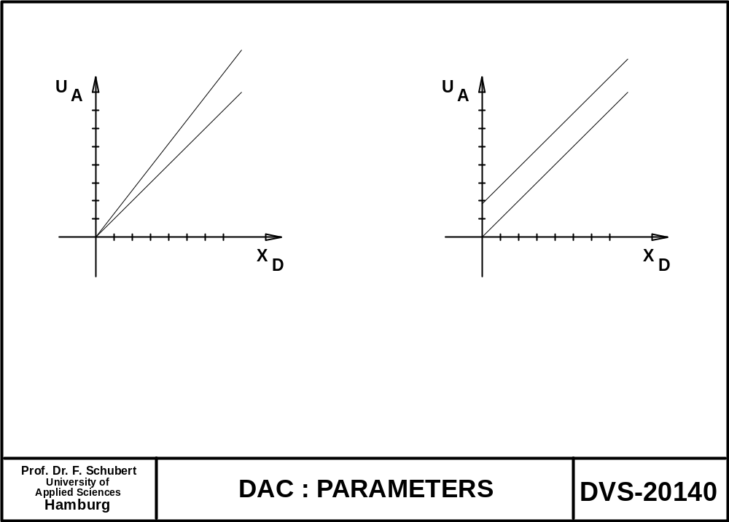
real
real
ideal
ideal
Gain error
Offset error

Slide 11
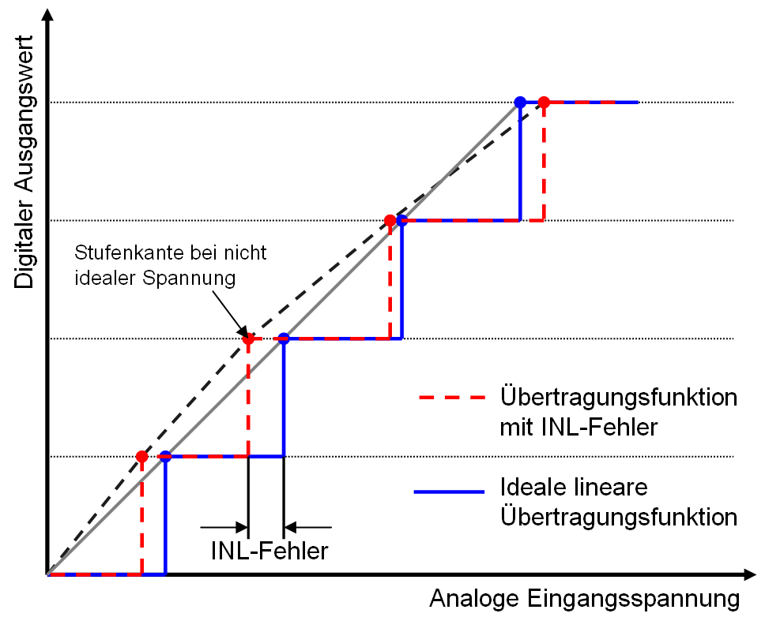
Integral Non-Linearity
INL:Max. Voltage difference ideal vs. Real
Whole curve
Digital output code
Real transfer function
Ideal transfer function
INL-Error
Analog input voltage

Slide 12
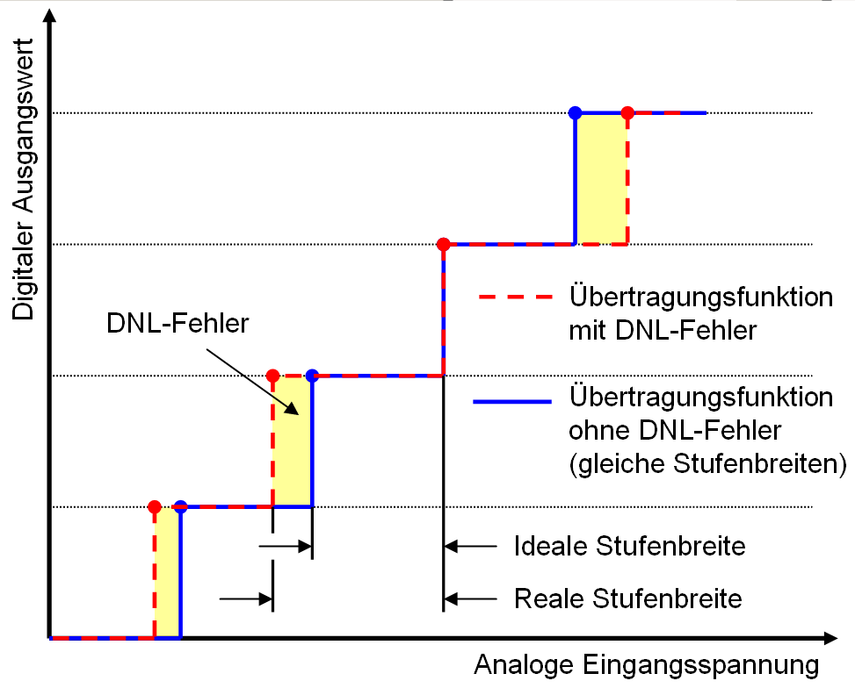
Differential Non-Linearity
DNL:Max. Voltage difference ideal vs. Real
One step
Digital output code
Real transfer function
INL-Error
Ideal transfer function
Ideal step width
Real step width
Analog input voltage

Slide 13
ANALOG-
A
MUX
S&H
D
INPUT
FILTER
AMPLIFIER
DIGITAL
PROCESSING
A
D
OUTPUT
RECONSTRUCTION
AMPLIFIER
FILTER
Prof. Dr. F. Schubert
PROCESSING AND
University of
DVS-20510
Applied Sciences
DISTRIBUTION OF SIGNALS
Hamburg

Slide 14
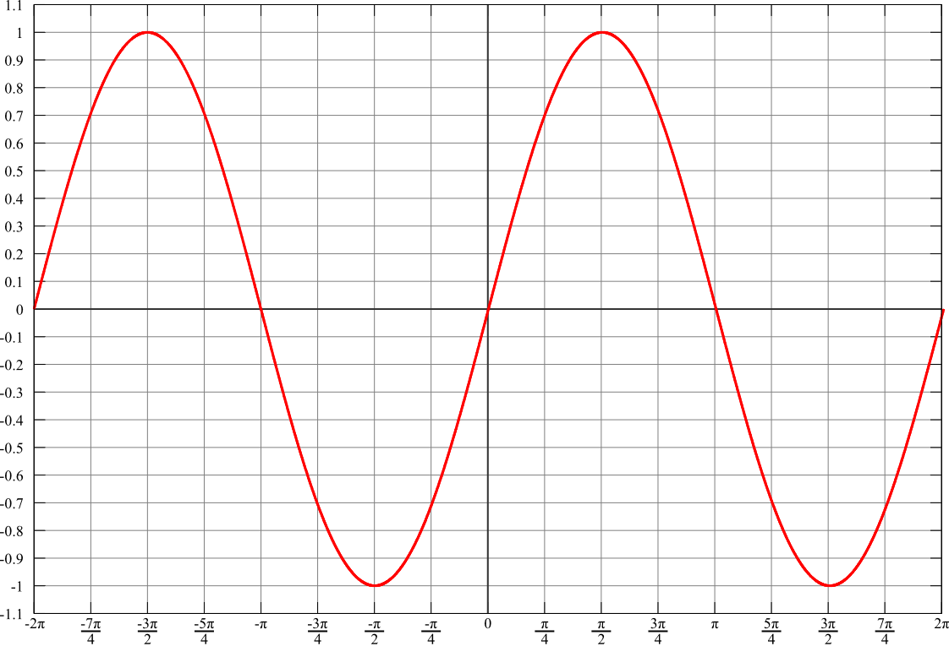
Sample&Hold stage needed to keep the analog value while the ADC is converting
input
output

Slide 15
Reconstruction filter (= low pass) is needed to smoothen the output signal / remove unused high signal frequencies
input
output

Slide 16
Chain S&H-ADC-DAC-Reconstruction filter completely restores the signal (not considering quantisation)

Slide 17
Video (16 min) on
N-2N DAC
ADC using this N-2N DAC
Sucessive approximation
link

Slide 18
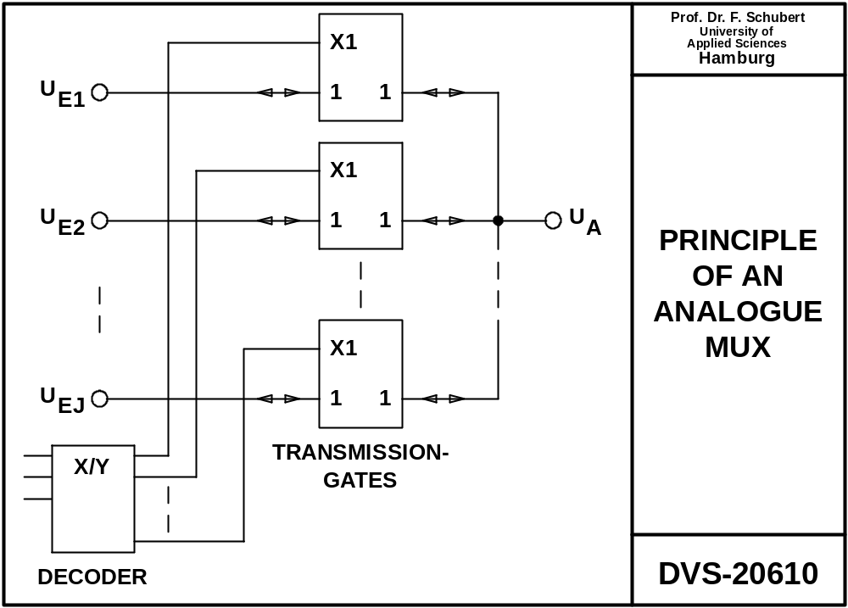

Slide 19
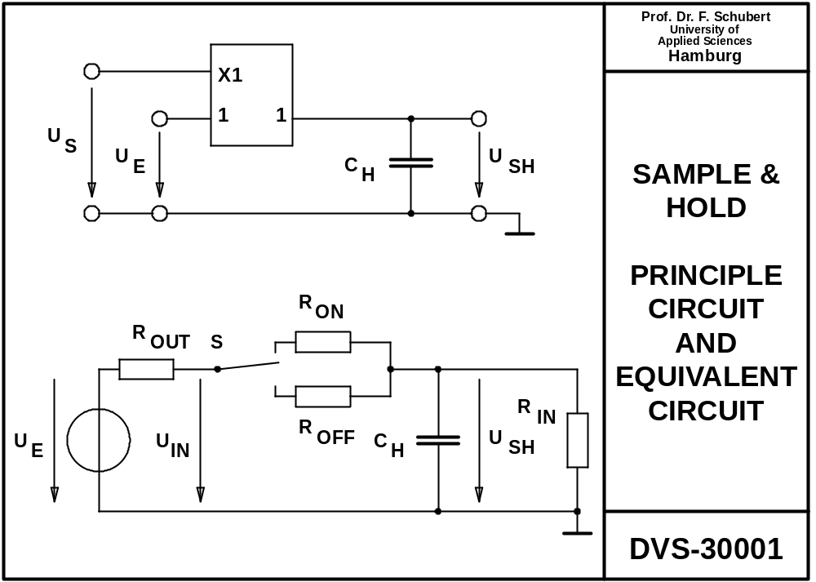

Slide 20
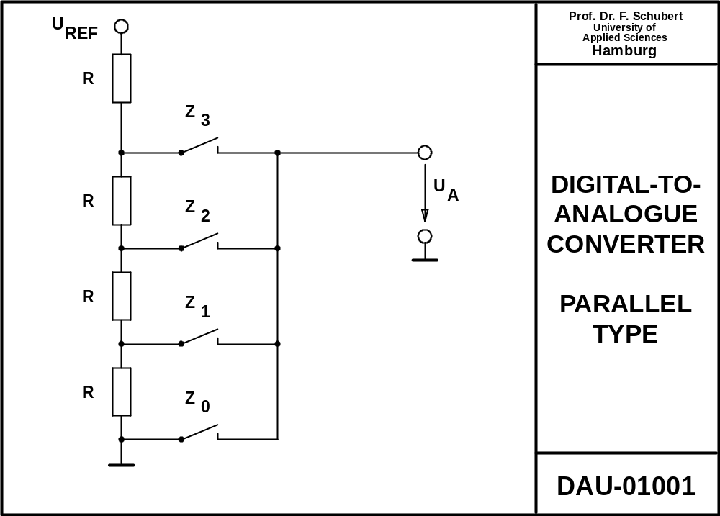
Decoder

Slide 21
Problem to be solved:
One code=one switch, one resistor!
16 Bit DAC → 65536 switches & resistors!

Slide 22
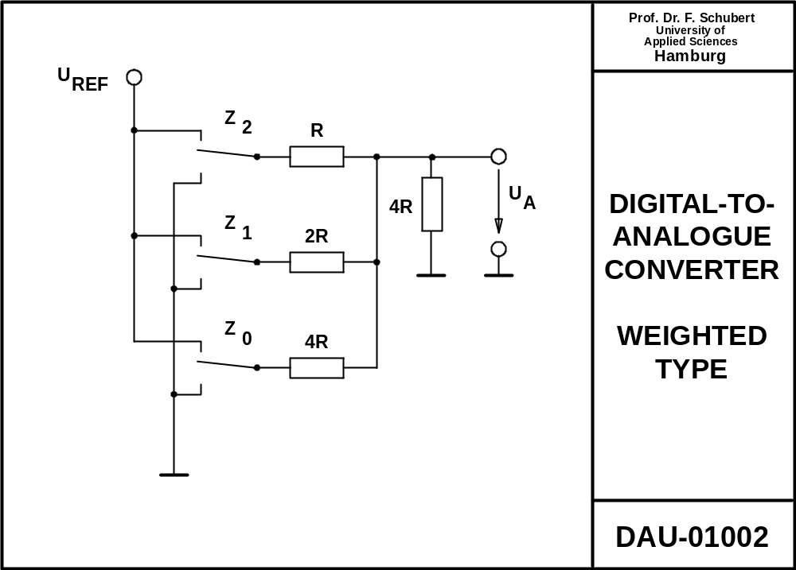

Slide 23
Problems to be solved:
Wide variation of resistor values
Internal resistor of source

Slide 24
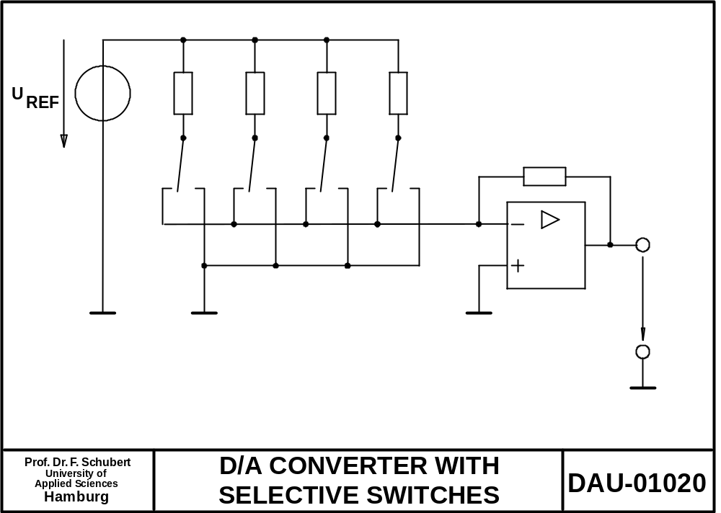
R
2R
4R
8R
R
z₃
z₂
z₁
z₀
MSB
V_{A}
LSB

Slide 25
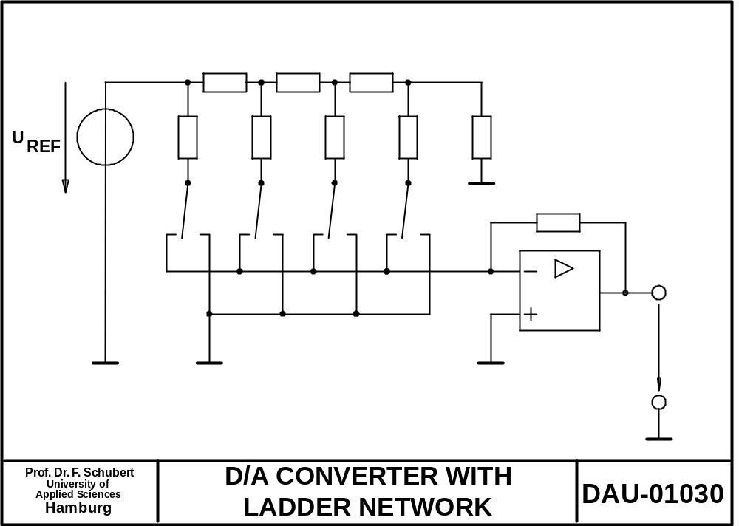
V_{REF} / 2
V_{REF} / 4
V_{REF} / 8
V_{REF}
R
R
R
2R
2R
2R
2R
2R
R
I
V_{A}

Slide 26
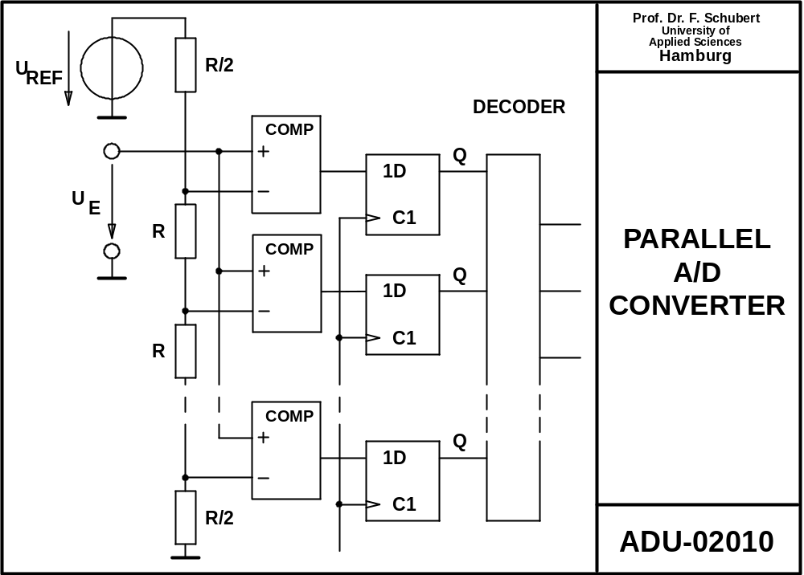
13/14 V_{ref}
7
Z₂
1
11/14 V_{ref}
Z₁
Z₀
0
1/14 V_{ref}

Slide 27
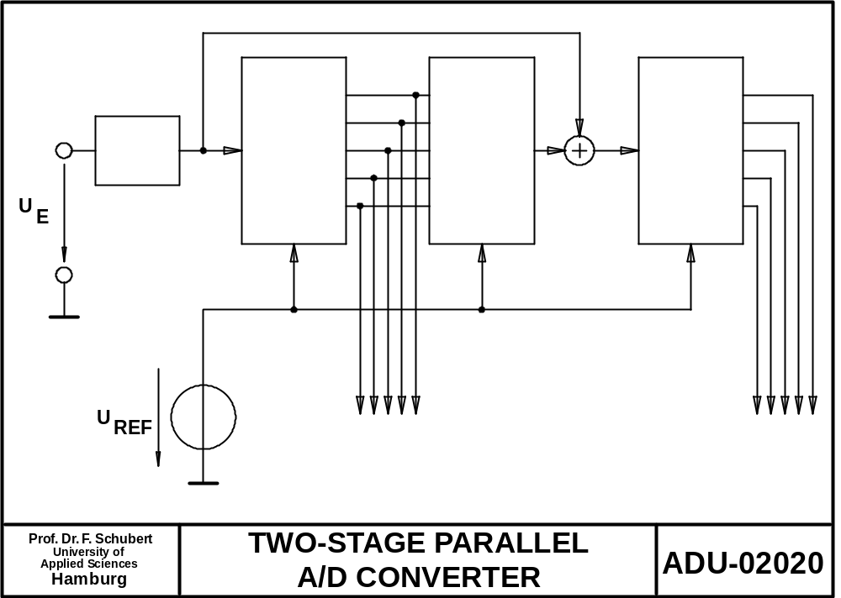
ADC1
DAC1
ADC2
S&H
MSBs
LSBs

Slide 28
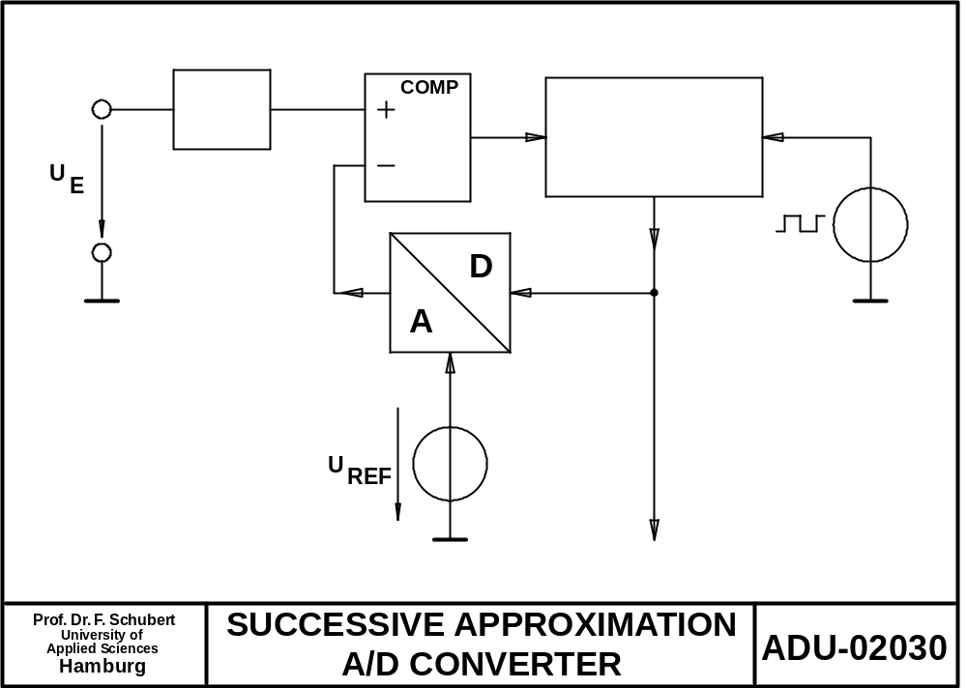
S&H
SAR
V_{DAC}(w)
w
w

Slide 29
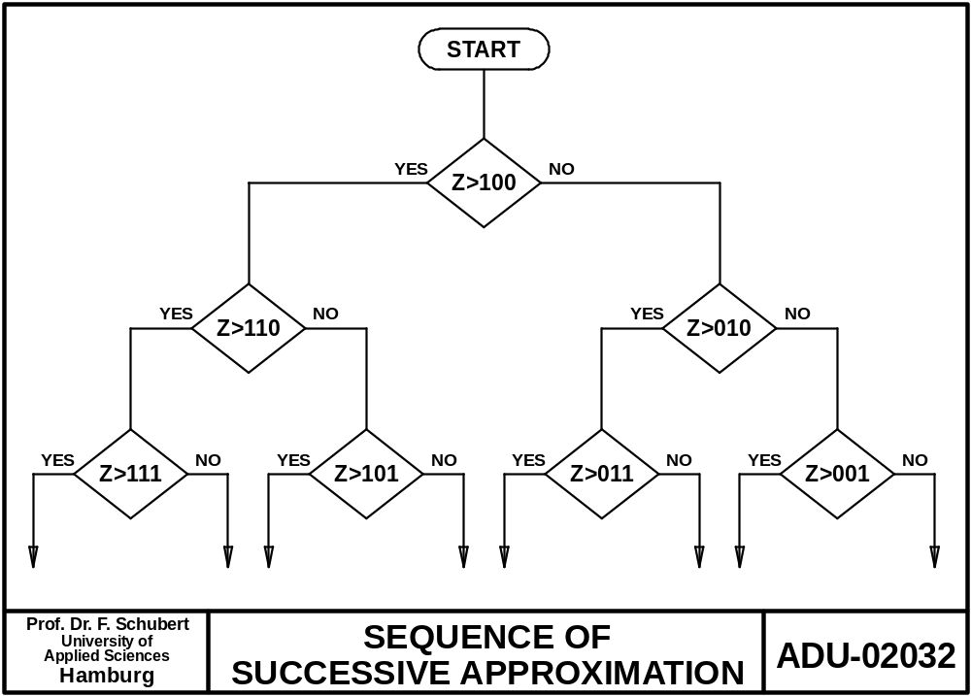
1..
0..
11.
10.
010.
00.
110
101
100
011
000
111
010
001

Slide 30
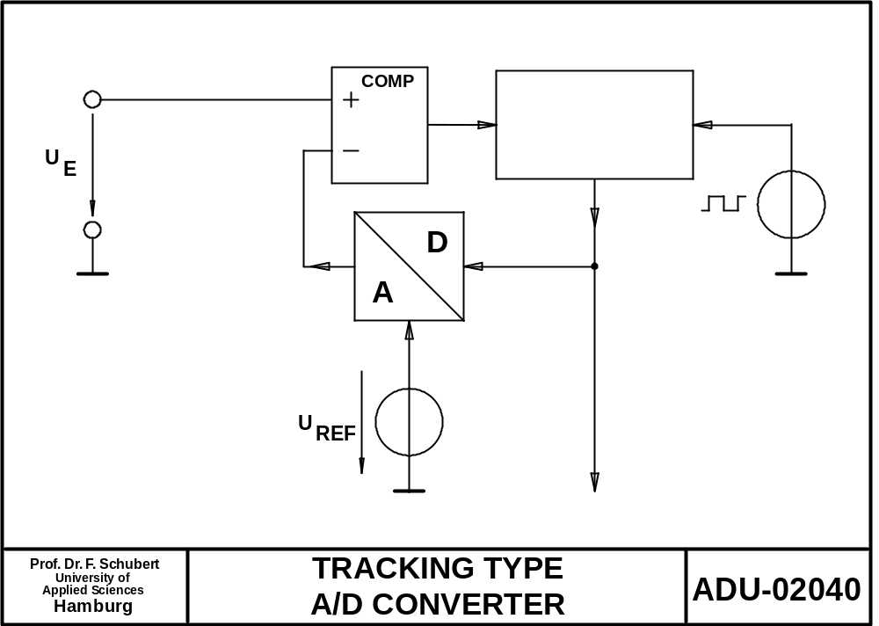
counter
V_{DAC}(w)
w
w

Slide 31
S&H
SAR
counter
V_{DAC}(w)
V_{DAC}(w)
w
w
w
w
Approximates in decreasing steps
N bits → N steps
Useful if new value if completely different to previous
Very commonly used
Approximates in equal steps
N bits → 2^{N} steps
Useful if new value if very similar to previous: then <<N steps
Rarely used

